Slide 1

Oblivion

Slide 2
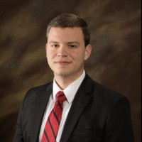
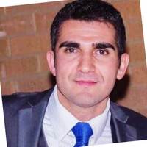
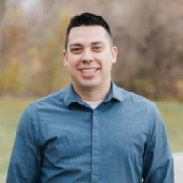
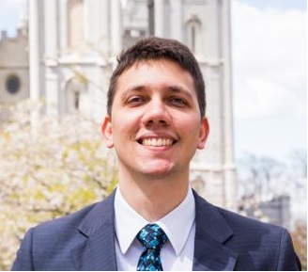
Who we are
Leo Santos
Leo Coelho
Henrique Vaz
Gui Nascimento

Slide 3
Purpose
The app will make your meetings approach enhanced so that you can optimize your time, assignments, communication, and aim to the right objective.

Slide 4
Problems Found
People forget their assignments
Only one person has the meeting minute
Hard to update/modify
Use of Paper

Slide 5
How to Solve?
Send Reminders
Everybody involved in the meeting has access to the meeting minute
Easy to update/modify
Paperless
Cloud Storage

Slide 6
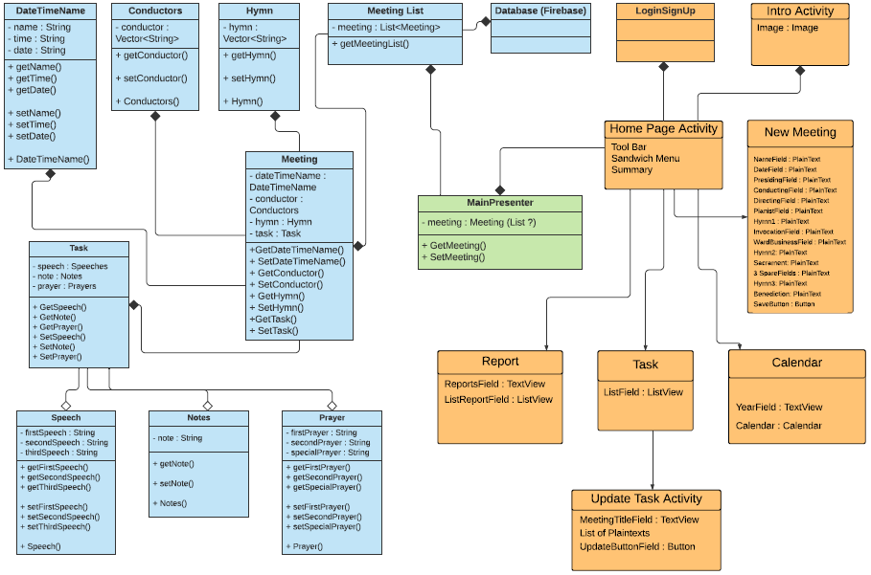
Functionality

Slide 7
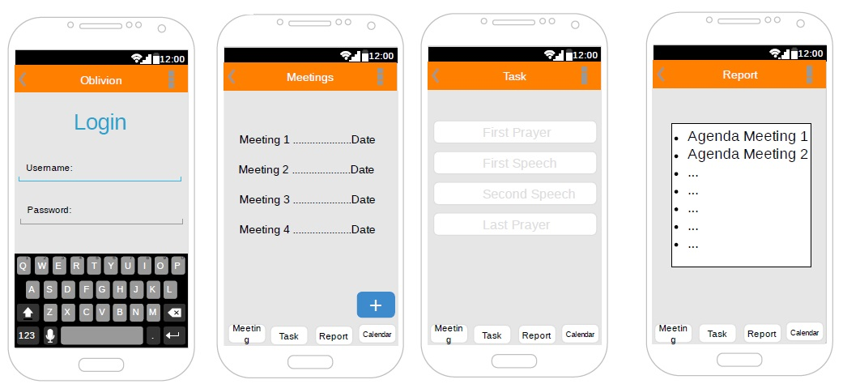
Add a Slide Title - 1

Slide 8
Future Plans
Expand to business and educational meetings
Create web application
Create an iOS version
Optimize the communication within and outside the app

